Slide 1
Algorithm Design for Big Data Systems
Divide and conquer
Graph algorithms
Streaming algorithms

Slide 2
Embarrassingly Parallel Problems
Problems that can be easily decomposed into many independent problems.
Examples.
Word count
k-means
PageRank

Slide 3
Divide and Conquer
code at: https://www.cse.ust.hk/msbd5003/nb/DC.ipynb

Slide 4
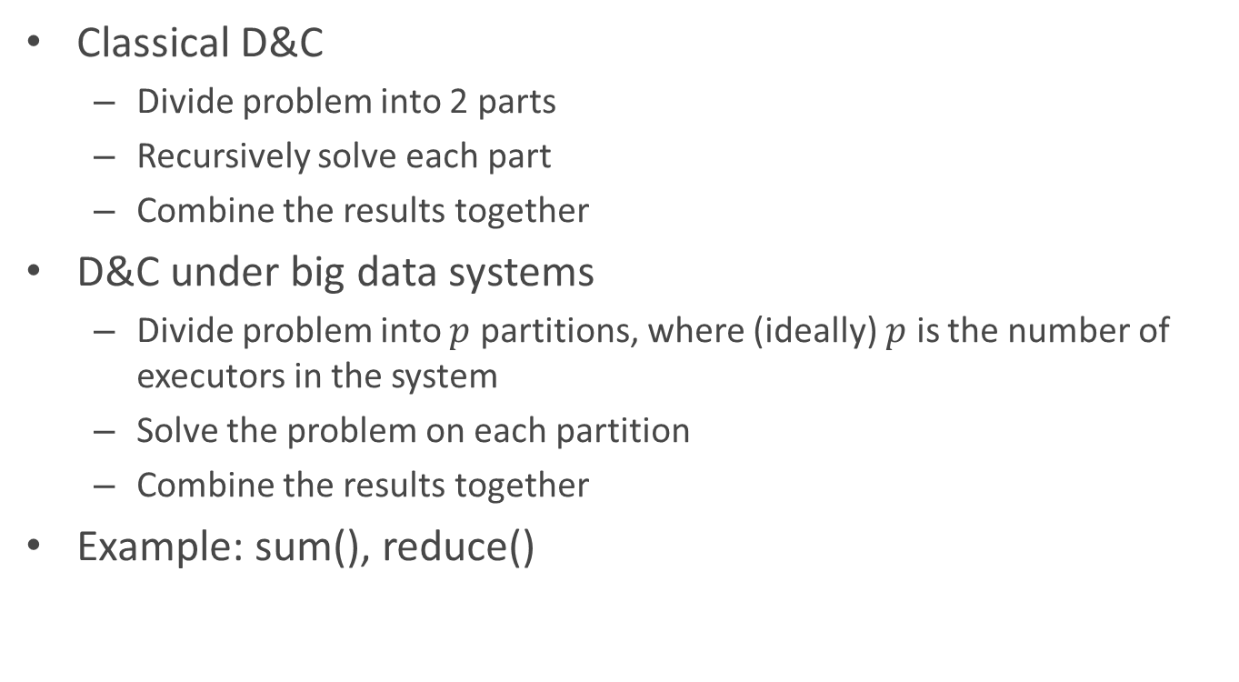
Classical Divide-and-Conquer
Classical D&C
Divide problem into 2 parts
Recursively solve each part
Combine the results together
D&C under big data systems
Divide problem into $p$ partitions, where (ideally) $p$ is the number of executors in the system
Solve the problem on each partition
Combine the results together
Example: sum(), reduce()

Slide 5
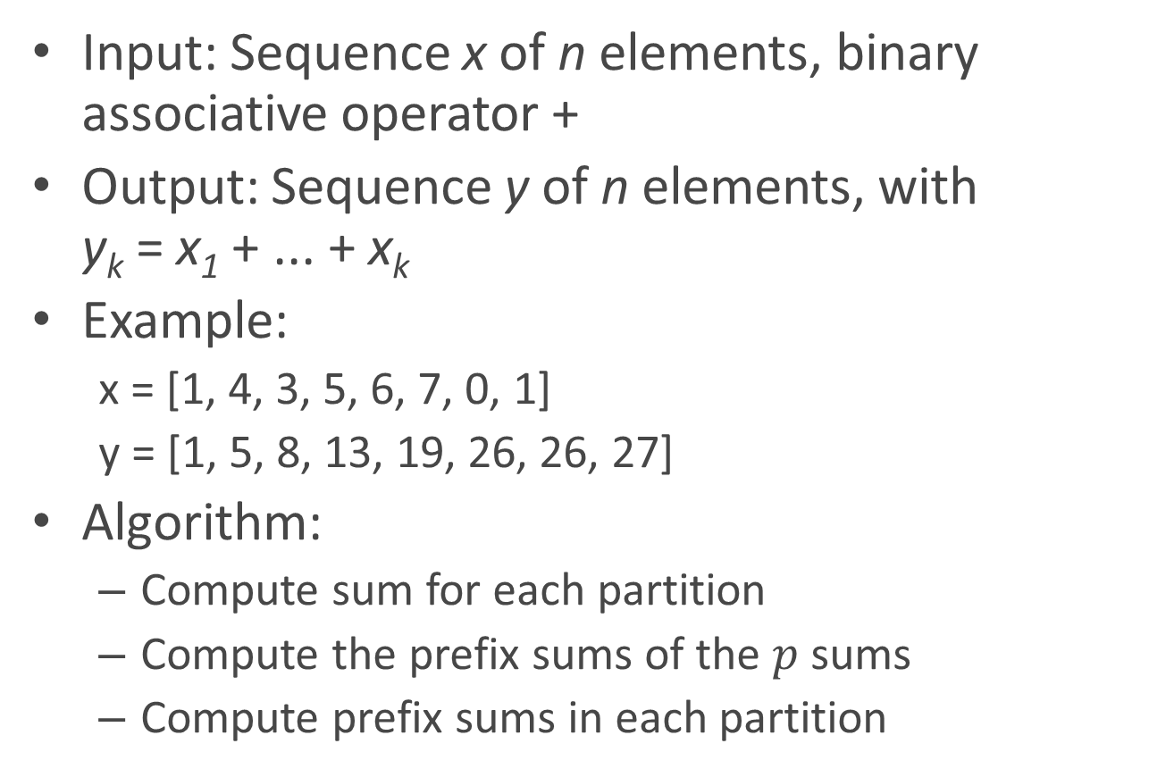
Prefix Sums
Input: Sequence x of n elements, binary associative operator +
Output: Sequence y of n elements, with y_{k} = x₁ + ... + x_{k}
Example:
x = [1, 4, 3, 5, 6, 7, 0, 1]
y = [1, 5, 8, 13, 19, 26, 26, 27]
Algorithm:
Compute sum for each partition
Compute the prefix sums of the $p$ sums
Compute prefix sums in each partition

Slide 6
Variants of Prefix Sums
Assign consecutive id’s for each element
zipWithIndex()
Given a list of words, find the first appearance of “spark”
Given two long strings, compare them lexicographically
Given a sequence of integers, check whether these numbers are moronically decreasing.

Slide 7
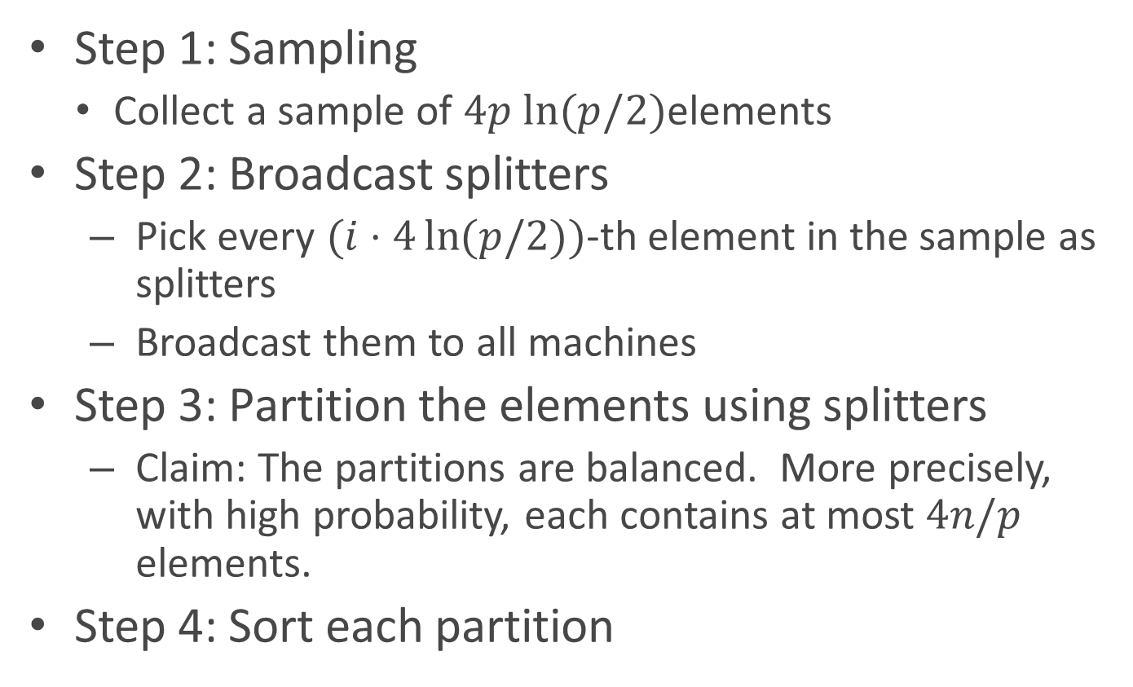
Sorting (Sample Sort)
Step 1: Sampling
Collect a sample of $4p ln(p/2)$elements
Step 2: Broadcast splitters
Pick every $(i⋅4\ln{(p/2)})$-th element in the sample as splitters
Broadcast them to all machines
Step 3: Partition the elements using splitters
Claim: The partitions are balanced. More precisely, with high probability, each contains at most $4n/p$ elements.
Step 4: Sort each partition

Slide 8
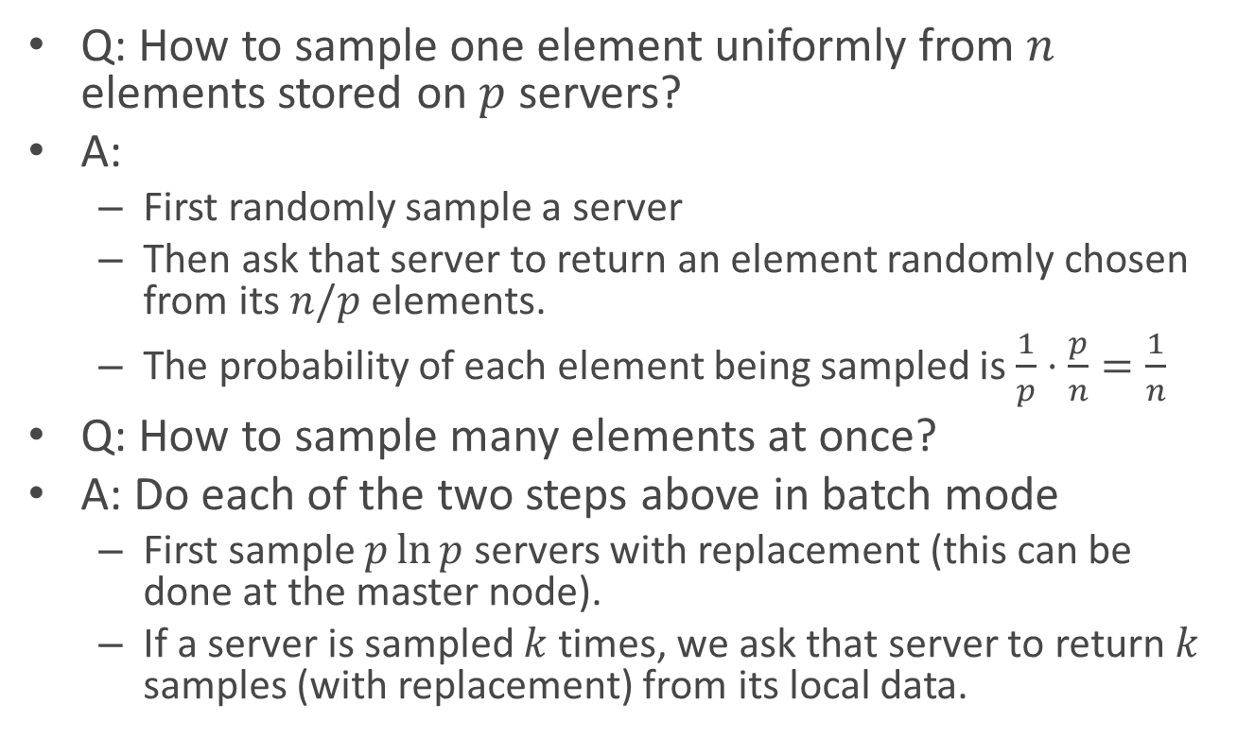
Distributed Sampling
Q: How to sample one element uniformly from $n$ elements stored on $p$ servers?
A:
First randomly sample a server
Then ask that server to return an element randomly chosen from its $n/p$ elements.
The probability of each element being sampled is$\frac{1}{p}⋅\frac{p}{n}=\frac{1}{n}$
Q: How to sample many elements at once?
A: Do each of the two steps above in batch mode
First sample $p\ln{p}$ servers with replacement (this can be done at the master node).
If a server is sampled $k$ times, we ask that server to return $k$ samples (with replacement) from its local data.

Slide 9
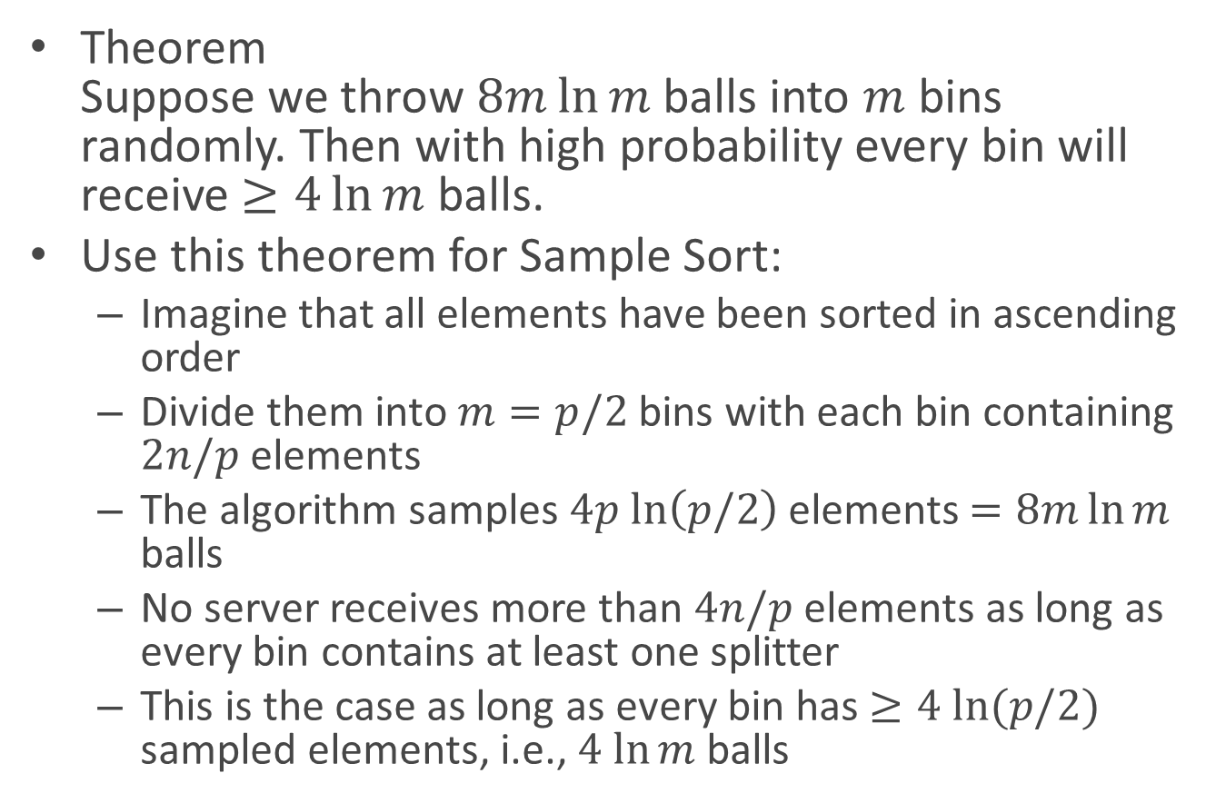
Balls and Bins
Theorem Suppose we throw $8m\ln{m}$ balls into $m$ bins randomly. Then with high probability every bin will receive $≥4\ln{m}$ balls.
Use this theorem for Sample Sort:
Imagine that all elements have been sorted in ascending order
Divide them into $m=p/2$ bins with each bin containing $2n/p$ elements
The algorithm samples $4p$ $ln\left(p/2\right)$ elements $=8m\ln{m}$ balls
No server receives more than $4n/p$ elements as long as every bin contains at least one splitter
This is the case as long as every bin has $≥4 ln⁡(p/2)$ sampled elements, i.e., $4 ln⁡m$ balls

Slide 10
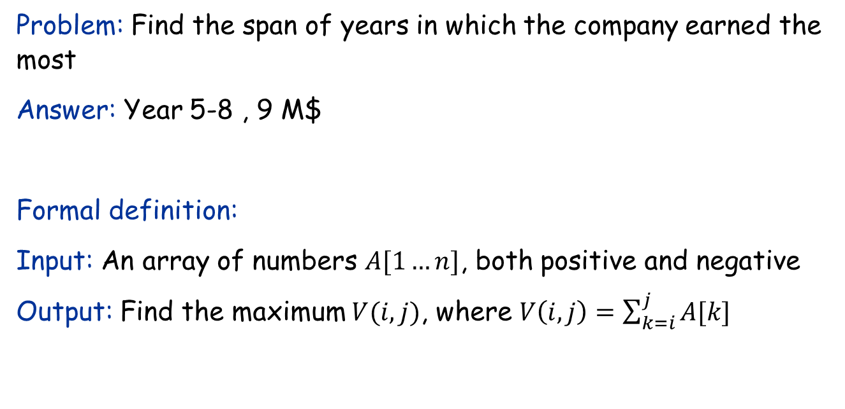
The Maximum Subarray Problem
Input: Profit history of a company of the years.
Year | 1 | 2 | 3 | 4 | 5 | 6 | 7 | 8 | 9
Profit (M$) | -3 | 2 | 1 | -4 | 5 | 2 | -1 | 3 | -1
Problem: Find the span of years in which the company earned the most
Answer: Year 5-8 , 9 M$
Formal definition:
Input: An array of numbers $A[1…n]$, both positive and negative
Output: Find the maximum $V(i,j)$, where $V\left(i,j\right)=\sum_{k=i}^{j}{A[k]}$

Slide 11
A divide-and-conquer algorithm
Year | 1 | 2 | 3 | 4 | 5 | 6 | 7 | 8 | 9
Profit (M$) | -3 | 2 | 1 | -4 | 5 | 2 | -1 | 3 | -1
Idea:
Cut the array into two halves
All subarrays can be classified into three cases:
Case 1: entirely in the first half
Case 2: entirely in the second half
Case 3: crosses the cut
Largest of three cases is final solution
The optimal solutions for case 1 and 2 can be found recursively.
Only need to consider case 3.

Slide 12
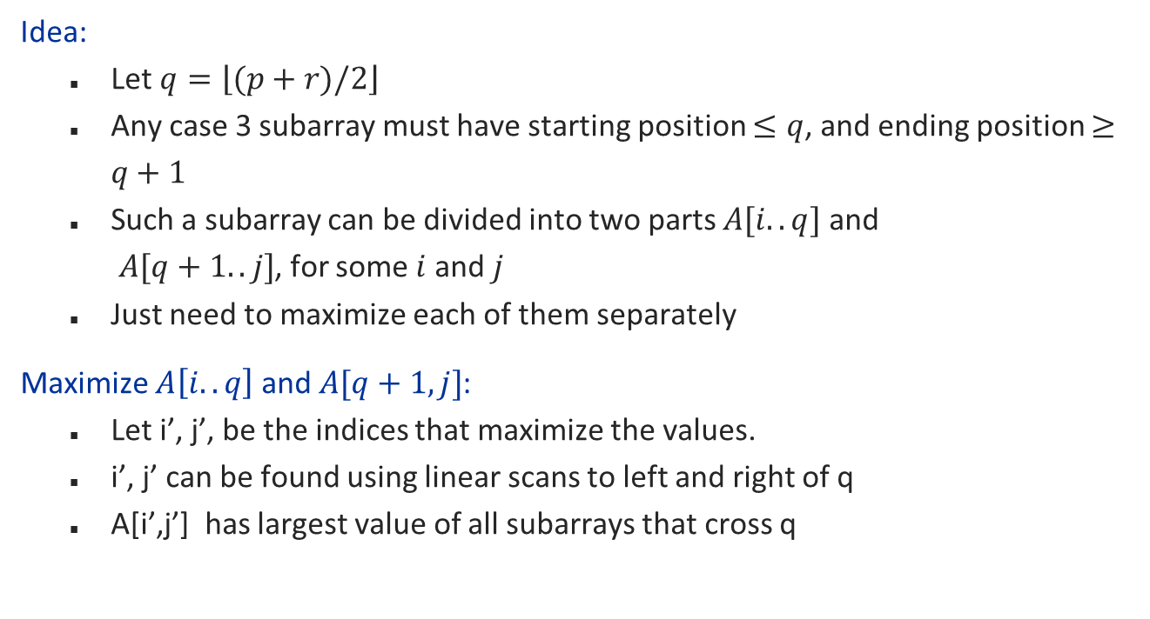
Solving case 3
Year | 1 | 2 | 3 | 4 | 5 | 6 | 7 | 8 | 9
Profit (M$) | -3 | 2 | 1 | -4 | 5 | 2 | -1 | 3 | -1
Idea:
Let $q=\left\lfloor (p+r)/2\right\rfloor$
Any case 3 subarray must have starting position $≤q$, and ending position $≥q+1$
Such a subarray can be divided into two parts $A[i..q]$ and $A[q+1..j]$, for some $i$ and $j$
Just need to maximize each of them separately
Maximize $A\left[i..q\right]$ and $A[q+1,j]$:
Let i’, j’, be the indices that maximize the values.
i’, j’ can be found using linear scans to left and right of q
A[i’,j’] has largest value of all subarrays that cross q

Slide 13
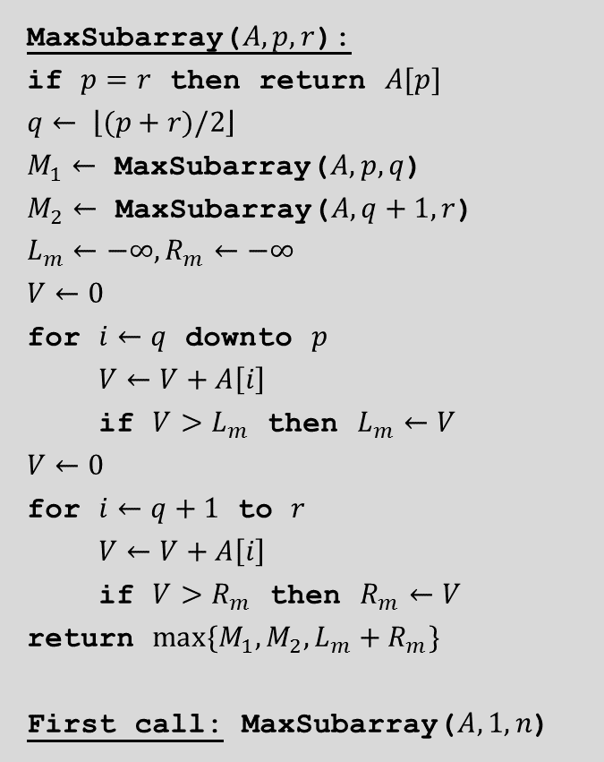
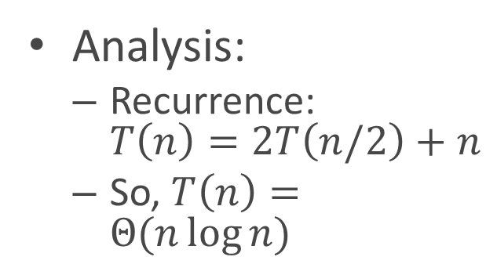
The (binary) divide-and-conquer algorithm
MaxSubarray($A, p, r$):
if $p=r$ then return $A[p]$
$$q← \left\lfloor (p+r)/2\right\rfloor$$
$M_{1}←$ MaxSubarray($A, p,q$)
$M_{2}←$ MaxSubarray($A, q+1, r$)
$$L_{m}←−∞,R_{m}←−∞$$
$$V←0$$
for $i←q$ downto $p$
$V←V+A\left[i\right]$
if $V>L_{m}$ then $L_{m}←V$
$$V←0$$
for $i←q+1$ to $r$
$V←V+A\left[i\right]$
if $V>R_{m}$ then $R_{m}←V$
return $max\{M_{1},M_{2},L_{m}+R_{m}\}$
First call: MaxSubarray($A, 1, n$)
Analysis:
Recurrence: $T\left(n\right)=2T\left(n/2\right)+n$
So, $T\left(n\right)=Θ(n\log{n)}$

Slide 14
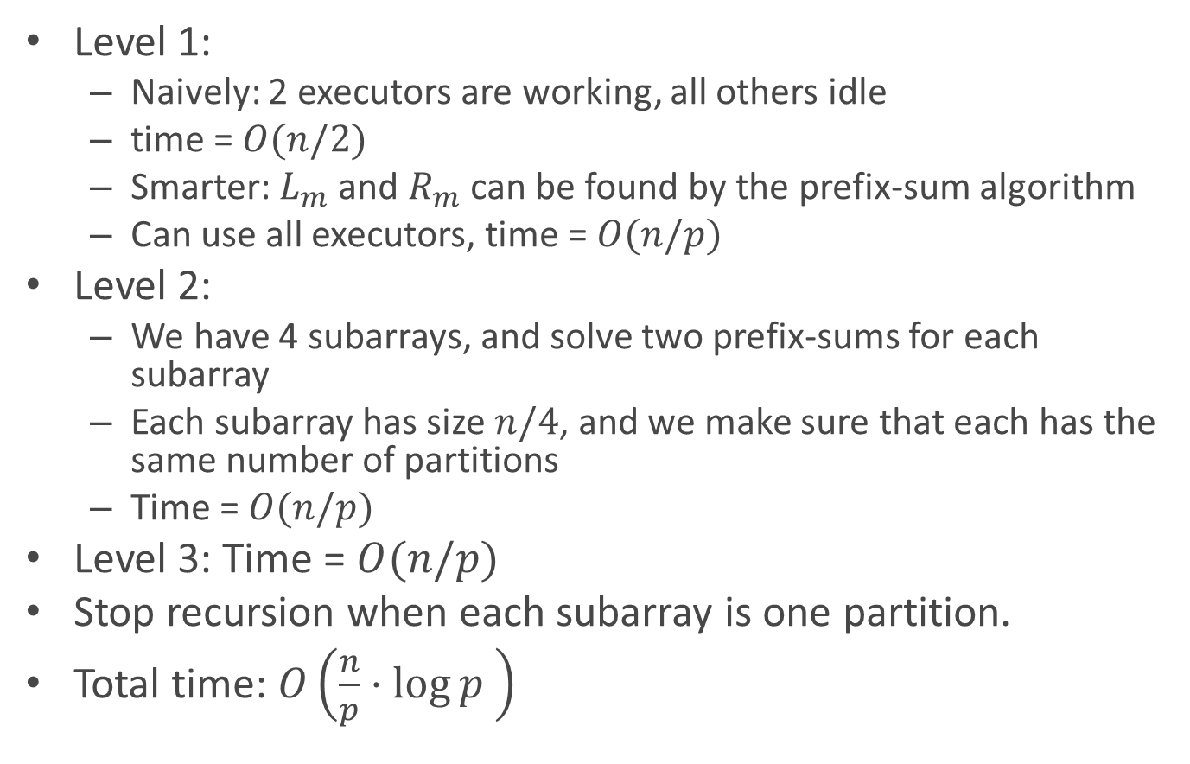
If we use the same algorithm on Spark:
Level 1:
Naively: 2 executors are working, all others idle
time = $O(n/2)$
Smarter: $L_{m}$ and $R_{m}$ can be found by the prefix-sum algorithm
Can use all executors, time = $O(n/p)$
Level 2:
We have 4 subarrays, and solve two prefix-sums for each subarray
Each subarray has size $n/4$, and we make sure that each has the same number of partitions
Time = $O(n/p)$
Level 3: Time = $O(n/p)$
Stop recursion when each subarray is one partition.
Total time: $O\left(\frac{n}{p}⋅\log{p }\right)$

Slide 15
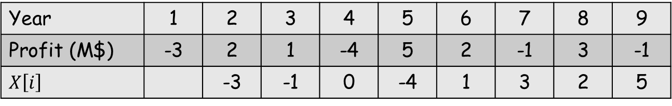

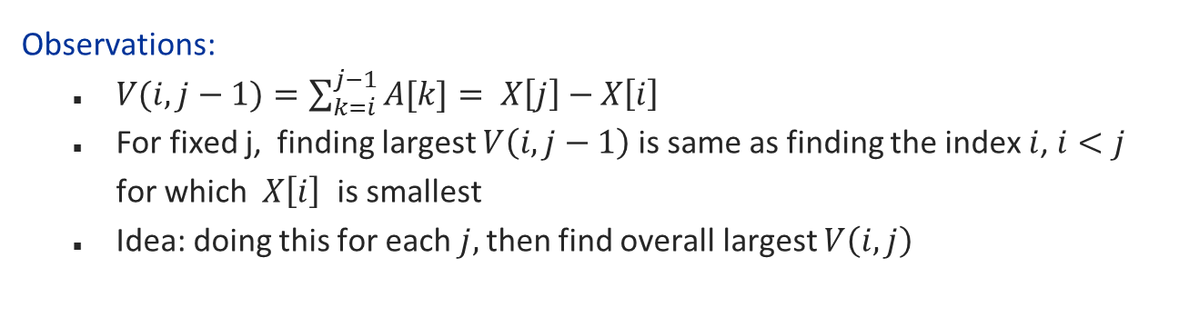
A linear-time algorithm?
Define: $X\left[i\right]=A\left[1\right]+…+A\left[i−1\right]$
Year | 1 | 2 | 3 | 4 | 5 | 6 | 7 | 8 | 9
Profit (M$) | -3 | 2 | 1 | -4 | 5 | 2 | -1 | 3 | -1
$$X\left[i\right]$$ |  | -3 | -1 | 0 | -4 | 1 | 3 | 2 | 5
Observations:
$V(i,j−1)=\sum_{k=i}^{j−1}{A[k]}= X\left[j\right]−X\left[i\right]$
For fixed j, finding largest $V\left(i,j−1\right)$is same as finding the index $i$, $i<j$ for which $X\left[i\right]$ is smallest
Idea: doing this for each $j,$then find overall largest $V\left(i,j\right)$

Slide 16
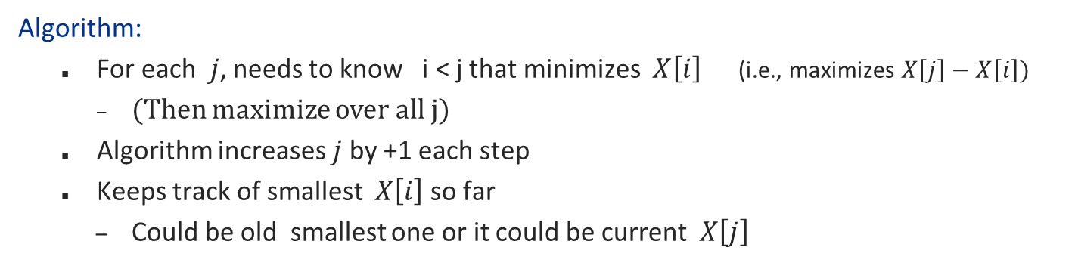

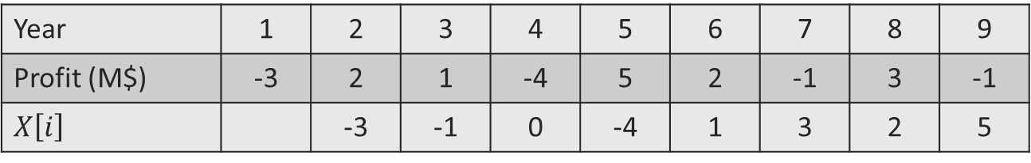
A linear-time (Θ(𝑛)) algorithm?
Define: $X\left[i\right]=A\left[1\right]+…+A\left[i−1\right]$
Goal: Find $\max_{i<j}{(X\left[j\right]−X\left[i\right])}$
Year | 1 | 2 | 3 | 4 | 5 | 6 | 7 | 8 | 9
Profit (M$) | -3 | 2 | 1 | -4 | 5 | 2 | -1 | 3 | -1
$$X\left[i\right]$$ |  | -3 | -1 | 0 | -4 | 1 | 3 | 2 | 5
Algorithm:
For each $j$, needs to know i < j that minimizes $X\left[i\right]$ (i.e., maximizes $X\left[j\right]−X\left[i\right]$)
(Then maximize over all j)
Algorithm increases $j$ by +1 each step
Keeps track of smallest $X\left[i\right]$ so far
Could be old smallest one or it could be current $X\left[j\right]$

Slide 17
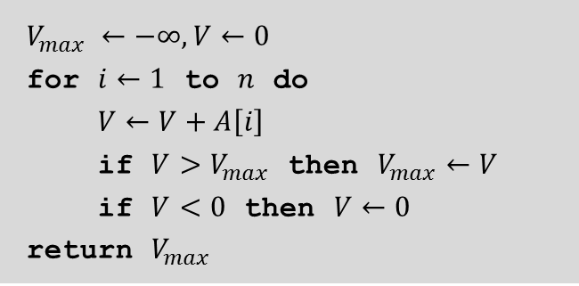
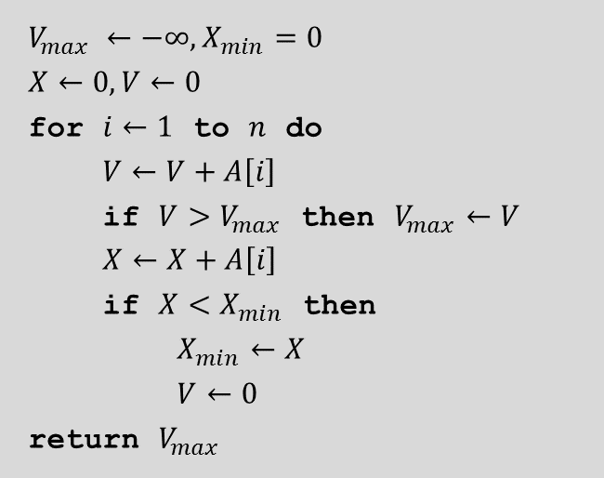
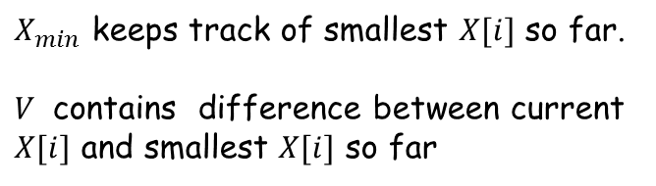
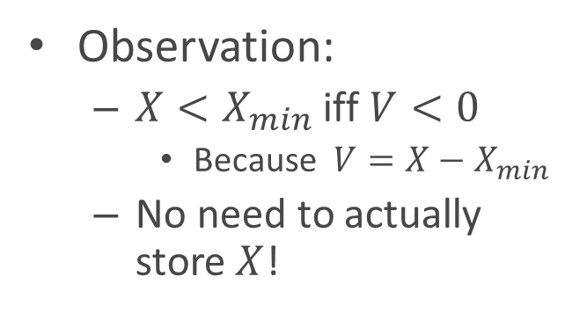
The linear-time algorithm
Even “simpler”:
$$V_{max} ←−∞,X_{min}=0$$
$$X←0,V←0$$
for $i←1$ to $n$ do
$V←V+A\left[i\right]$
if $V>V_{max}$ then $V_{max}←V$
$X←X+A\left[i\right]$
if $X<X_{min}$ then
$X_{min}←X$
$V←0$
return $V_{max}$
$$V_{max} ←−∞,V←0$$
for $i←1$ to $n$ do
$V←V+A\left[i\right]$
if $V>V_{max}$ then $V_{max}←V$
if $V<0$ then $V←0$
return $V_{max}$
Observation:
${X<X}_{min}$ iff $V<0$
Because ${V=X−X}_{min}$
No need to actually store $X$!
$X_{min}$ keeps track of smallest $X[i]$ so far.
$V$ contains difference between current $X[i]$ and smallest $X[i]$ so far

Slide 18
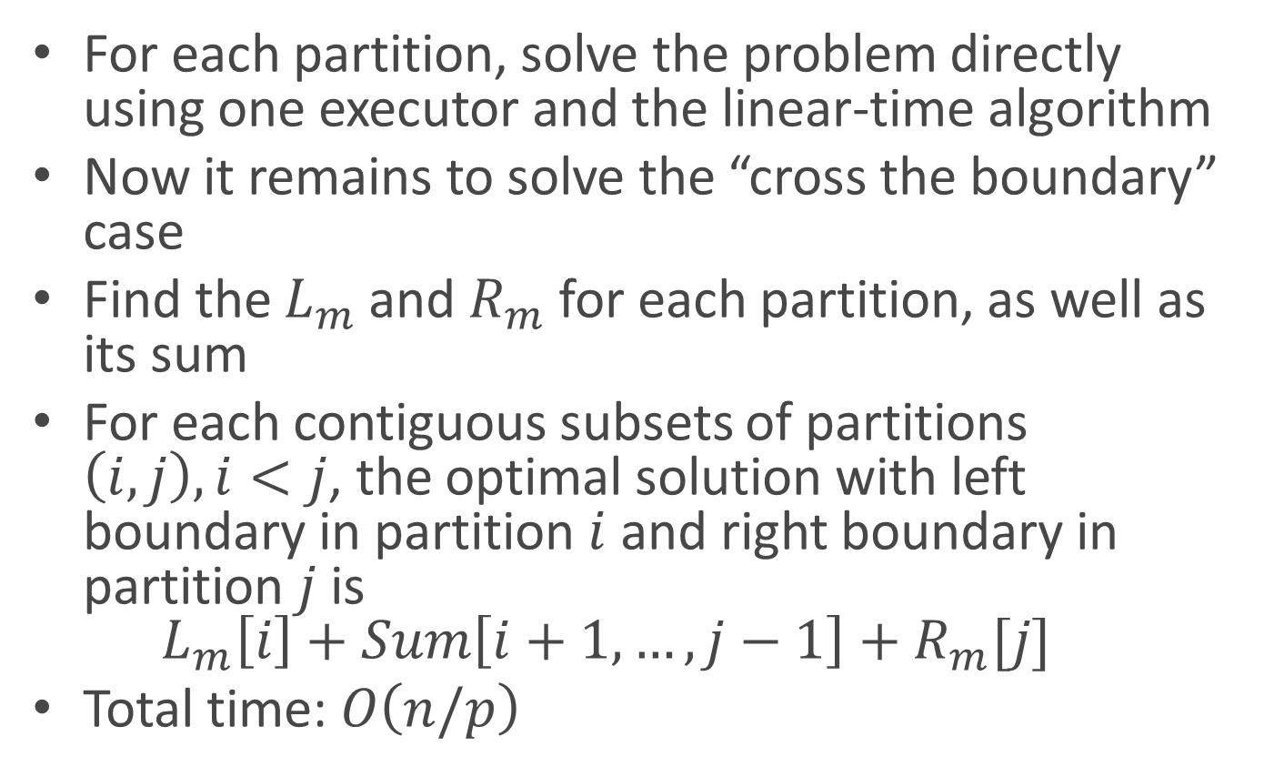
A simpler and more efficient algorithm
For each partition, solve the problem directly using one executor and the linear-time algorithm
Now it remains to solve the “cross the boundary” case
Find the $L_{m}$ and $R_{m}$ for each partition, as well as its sum
For each contiguous subsets of partitions $\left(i,j\right), i<j$, the optimal solution with left boundary in partition $i$ and right boundary in partition $j$ is $L_{m}\left[i\right]+Sum\left[i+1,…,j−1\right]+R_{m}[j]$
Total time: $O\left(n/p\right)$

